Slide 1
Magento
https://www.siteground.com/tutorials/magento/
(Tutorial for Magento Installation and Usage)
Creating a Magento Website
- Pages Management
- Magento Products
-Payment Methods
-Shipping Methods
To get into Magento, after successful installation one has to type localhost/magento2 or localhost/magento in web browser.

Slide 2
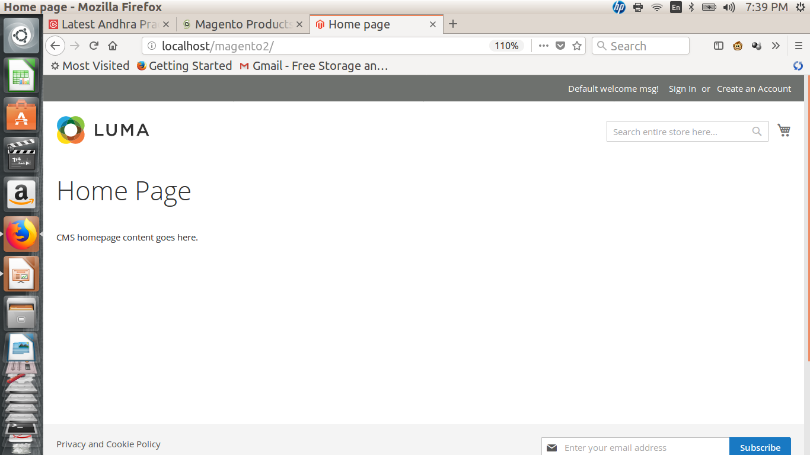
Magento
The following window will get open which is a home page of Magento website.

Slide 3
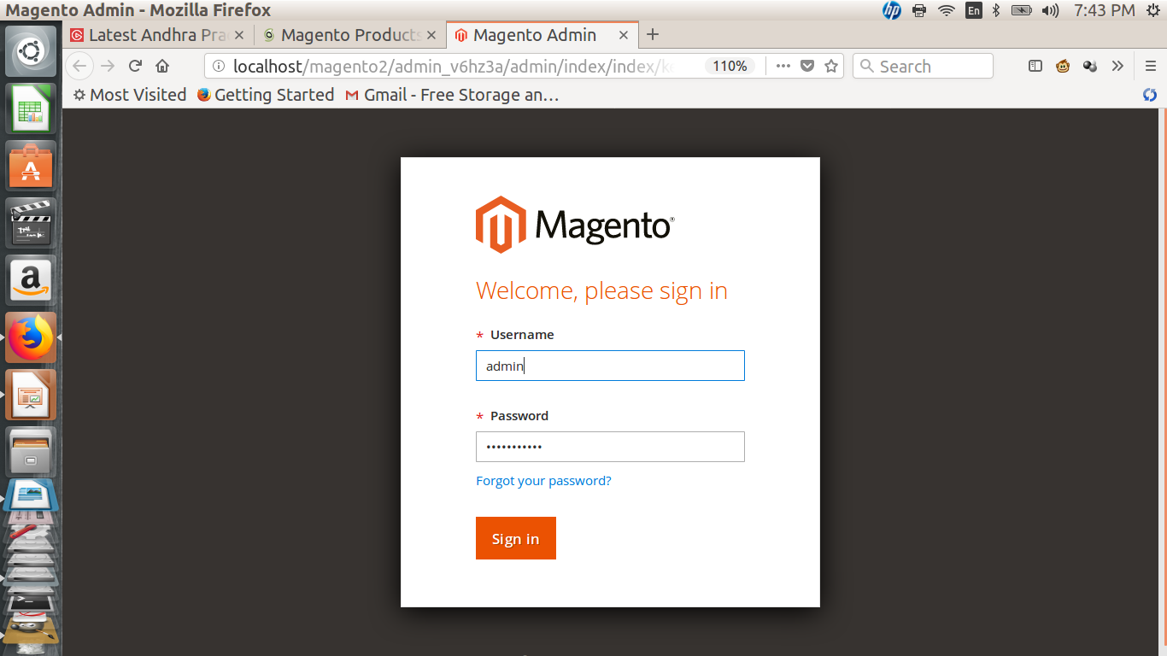
Admin page:

Slide 4
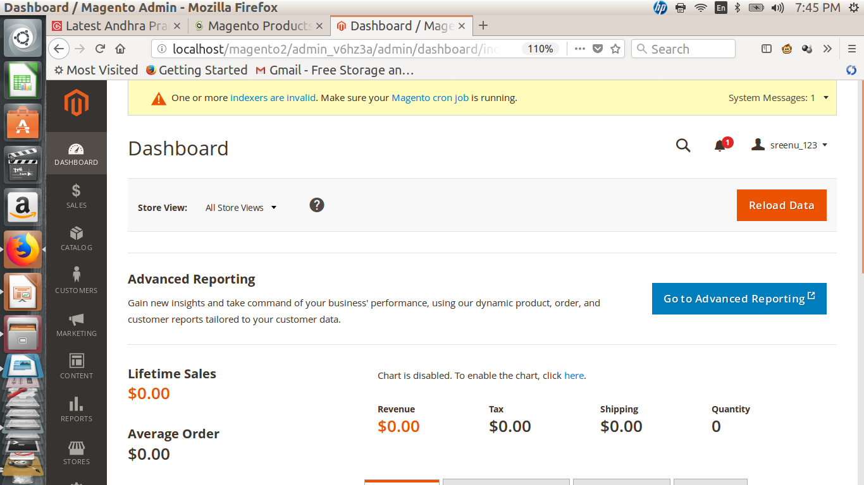

Slide 5
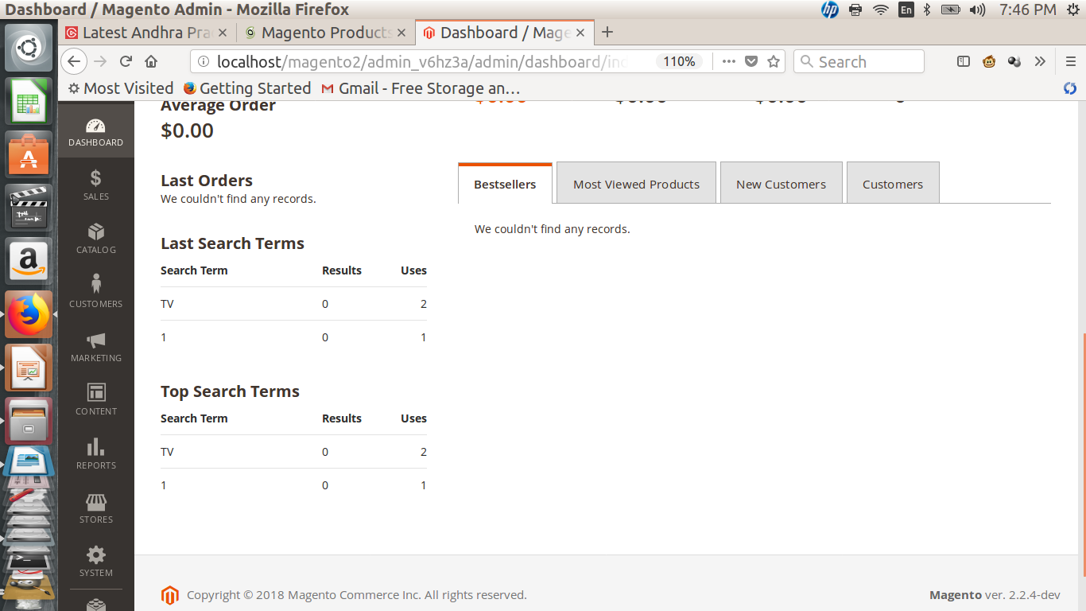

Slide 6
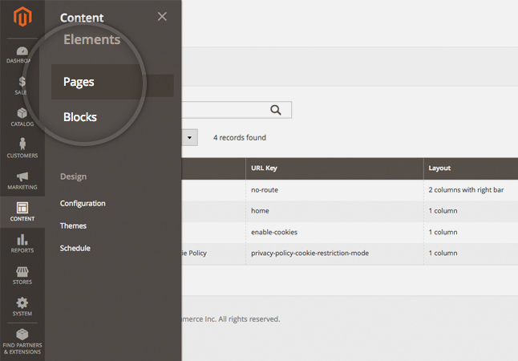
Magento
How to create Pages in Magento???
In order to add new pages or edit the existing ones in Magento, you should go to the Content menu and click on the Pages option under Elements section.

Slide 7
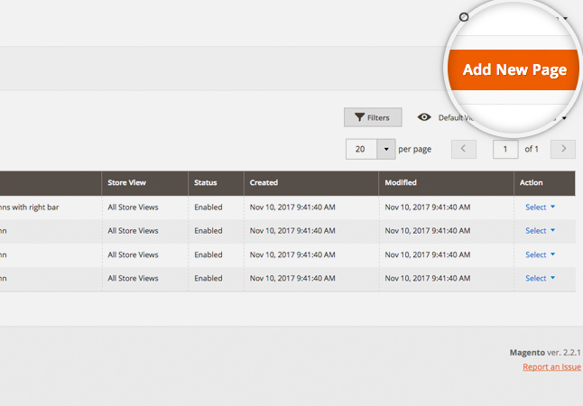
Magento
Magento 2 comes with 4 default pages but if you want to create a new one, you should click on the Add New page button.

Slide 8
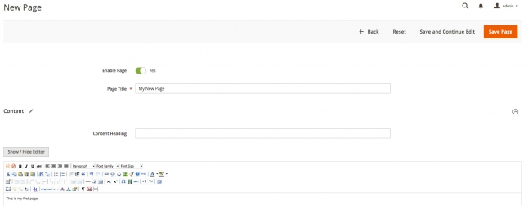
Magento
Clicking that button would redirect you to the new page addition option where you may add Page Title, Content Heading, Content, SEO options, Theme, etc.

Slide 9
When you fill in the desired option - just click on the Save page button and that's it - you have added the new page.
In case you want to edit an already existing page, again go to the Content menu and click on the Pages option under Elements section. Now just choose the page you want to edit and click on it to preview the main editing options such as Title, URL key, Status, etc.

Slide 10
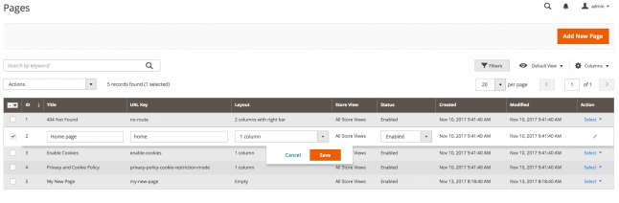
In case you want to edit other part of the page such as its content, you should expand the Select menu and click on the Edit button from the drop down menu.

Slide 11
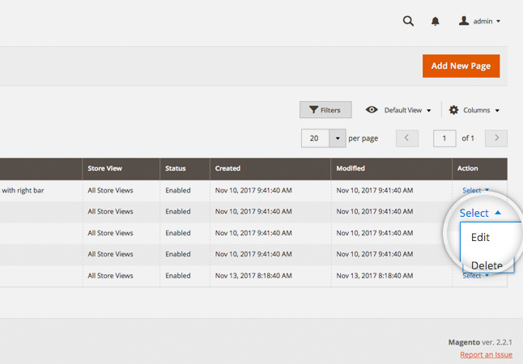

Slide 12
Adding Products in Magento
One of the most important parts of managing an e-commerce application is the products. In Magento this process consists of a few main parts.
Add Products in Magento
To add a new product in your Magento website you should go to the Magento admin panel > Catalog > Products. Afterwards click on the Add product button at the top right of the page.

Slide 13
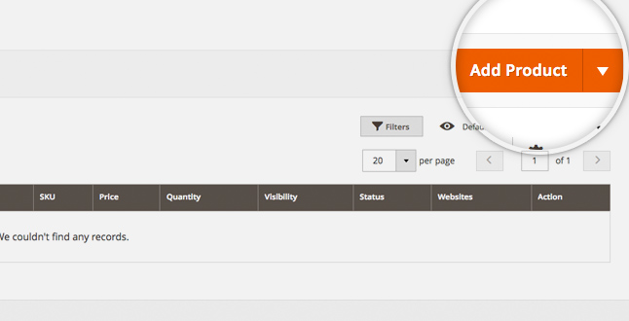

Slide 14
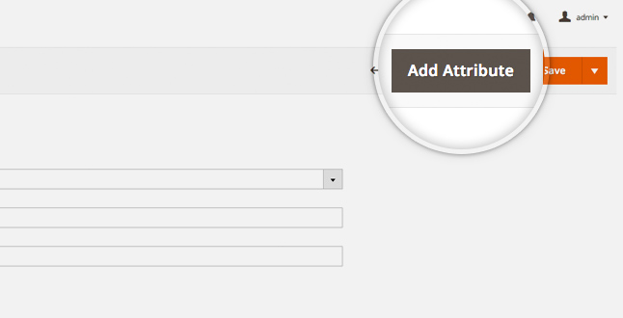
This would redirect you to the next page where you should input the product's options like Attribute set, Product name, SKU, price, etc. There is also option to add Images, Videos, setup URL key and much more. You may review all of the available options when you scroll down. You may also add a new attribute if necessary by clicking on the Add attribute button.
This would open a pop-up window which you may use to add the desired Attribute. When ready, click on the Save attribute button

Slide 15
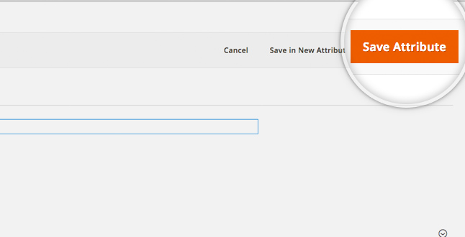
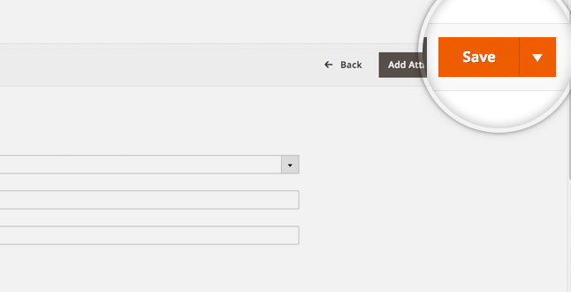
When you fill in the necessary details for your product - just click on the Save button

Slide 16
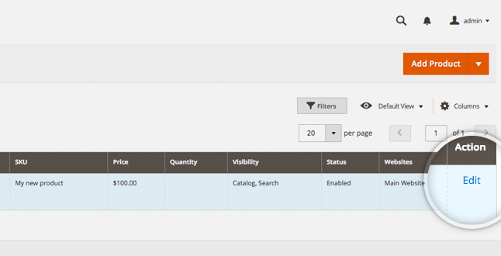
Add Media to Your Products
Adding an image to an existing product is easy in Magento. What you need to do is go to the Catalog > Products page and select the product you want to add image for or click on the Edit link in the Action menu.

Slide 17
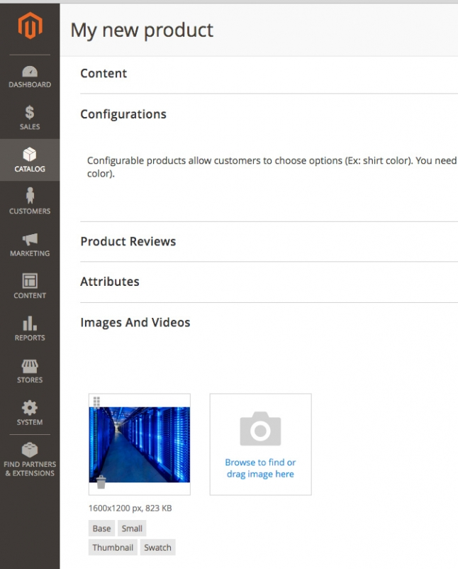
You will be automatically redirected to edit the product where you should scroll down to the Images and Videos section. To browse for an Image click on the Browse to find or drag image here icon. As the name of the icon suggests, Magento 2 provides the option to drag an image to upload it.

Slide 18
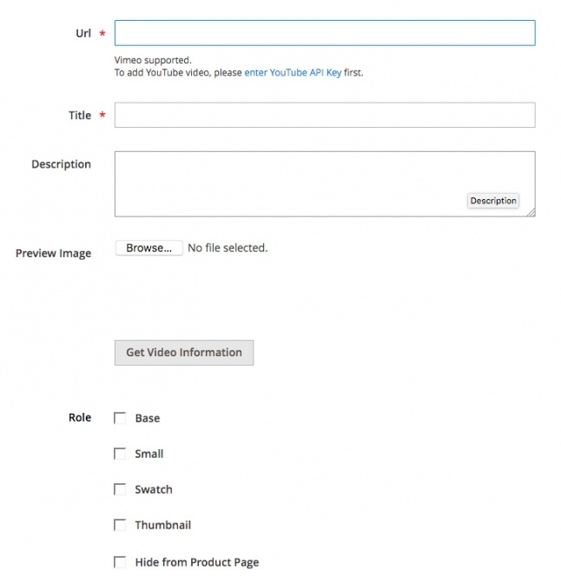
To add a video, just click on the Add Video button and a pop-up window would appear.

Slide 19
Here you may browse for video or fill in the URL of the video. Once ready - click on the Save button.
When the desired media is added - make sure to save the product using the Save button.
Manage Product Attributes
In order to access the available product attributes you should go to the Stores menu and select Product under the Attributes section.

Slide 20
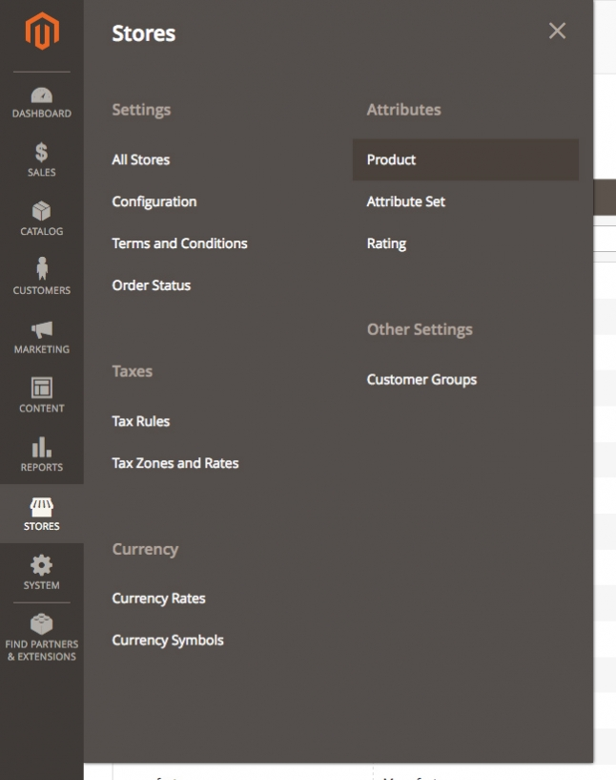

Slide 21
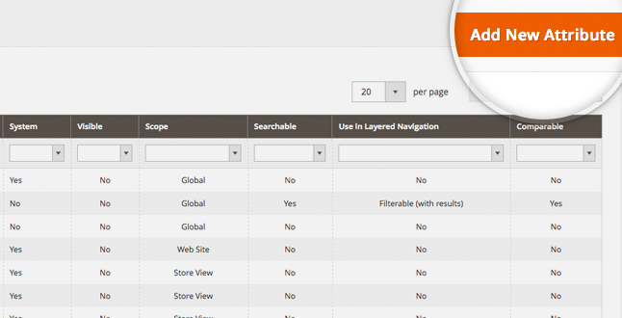
To create a new Attribute you should click on the Add new attribute button.

Slide 22
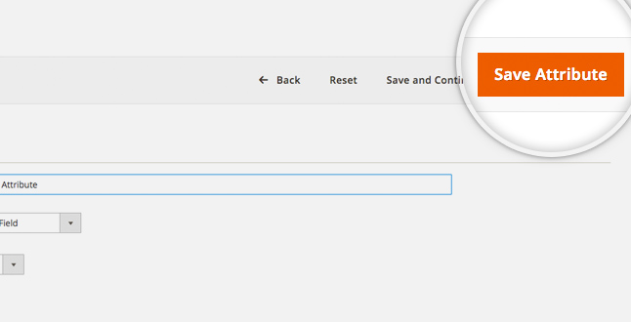
Once you are ready with the attribute, click on the Save Attribute button.

